Slide 1



Final Conference
Amman – September 2018

Slide 2
Innovation Management
Dr. Paulo Baptista

Slide 3

1. The Concept of Innovation
The word “innovative” comes from the Latin word “innovatione”, that means renewal.

Slide 4
1. The Concept of Innovation
“Innovation is criativity and its apllication.”
Bruno Libert - President of l’association Alliances and Ex-Director of Crédit Géneral Industriel

Slide 5
1. The Concept of Innovation
“If you are not capable to be different you will be condemned.”
Roberto Goizueta, ex-CEO of Coca-Cola

Slide 6
1. The Concept of Innovation
“The opposite of innovation is archaism and routine.”
Green book of Innovation, European Commission, 1996

Slide 7
1. The Concept of Innovation
“Innovation is an interactive and tumultuous process… that connects a global network of sources of knowledge to the unexpected needs of the clients.”
James Brian Quinn

Slide 8
1. The Concept of Innovation
“Innovation is the production, assimilation and exploitation well succeded of novelty.”
Green Book of Innovation, European Commission, 1996

Slide 9
1. The Concept of Innovation
“Innovation is the launching of a new product in the market that shall be significantly different of the other ones. Implies new production processes and the opening of new markets.”
Schumpeter

Slide 10
1. The Concept of Innovation
“Innovation is:
The renewal and enlargement of the range of products, services and associated markets;
The creation of new methods of production, storing and distribution;
The introduction of changes in the management, in the work organization, as well as, in the skills of the workers.”
Green Book of Innovation, European Commission, 1996

Slide 11
2. The Importance of Innovation Management
THE RISKS OF INNOVATING
Being passed through by the other partners when the innovation process is done within a partnership / The risks of sharing the Know-How;
Being passed by competitors doing benchmarking;

Slide 12
2. The Importance of Innovation Management
THE RISKS OF INNOVATING
The company can become dependent of the new product;
The innovation process can imply large investment that can not be recovered during the life cycle of the product;
or service is not accepted by the market;

Slide 13
2. The Importance of Innovation Management
THE RISKS OF NOT INNOVATING
Products and/or services becomes obsolete to the market needs;
The company looses rentability;
The company image looses notoriety;
The company looses competitiveness;

Slide 14
2. The Importance of Innovation Management
THE RISKS OF NOT INNOVATING
The company looses market share;
The company looses business opportunities;
The company looses the leadership of the technology standards;
The life cycle of the products is reduced.

Slide 15
2. The Importance of Innovation Management
THE RISK OF NOT INNOVATING
“The companies takes to much attention to the cost of doing something. They should be more worried with the costs of doing nothing.”
Philip Kotler, Marketing Guru

Slide 16
2. The Importance of Innovation Management
THE RISK OF NOT INNOVATING
“In this company you will be fired for not committing mistakes.”
Steven Ross, CEO of Time Warner

Slide 17
2. The Importance of Innovation Management
It should be mandatory for companies to establish:
=> clear innovation objectives
=> mechanisms for innovation management
To drive development and to reduce the associated risks

Slide 18
2. The Importance of Innovation Management
Innovation management is a crucial activity to ensure appropriate integration of innovation in the company's strategy and to maximize the likelihood of success of innovations that are developed.

Slide 19
2. The Importance of Innovation Management
Innovation should not be limited only to the management of the innovation process but be present from initial idea generation to evaluation of the impact of innovation, through the collection, screening and development of ideas and the implementation of innovation.

Slide 20
3. Innovation Management
3.1. PRINCIPLES
Innovation should be an element of the strategy of a company and its management should be a component of its overall policy.
As there are various forms of management of the companies, there are also different models of innovation management.

Slide 21
3. Innovation Management
Among the elements to which it is possible to combine different forms of approach are:
The focus and emphasis on objectives;
The central factor in the development of the product, process or service;
The process of creating the concept of the product, process or service;
The flow of activities;
The development process;
The organization of the innovation process.

Slide 22
3. Innovation Management

Slide 23
3. Innovation Management
The opportunities for innovation can have multiple origins and be of different natures, such as:
Social,
Economic,
Technological,
Political,
Legal.

Slide 24
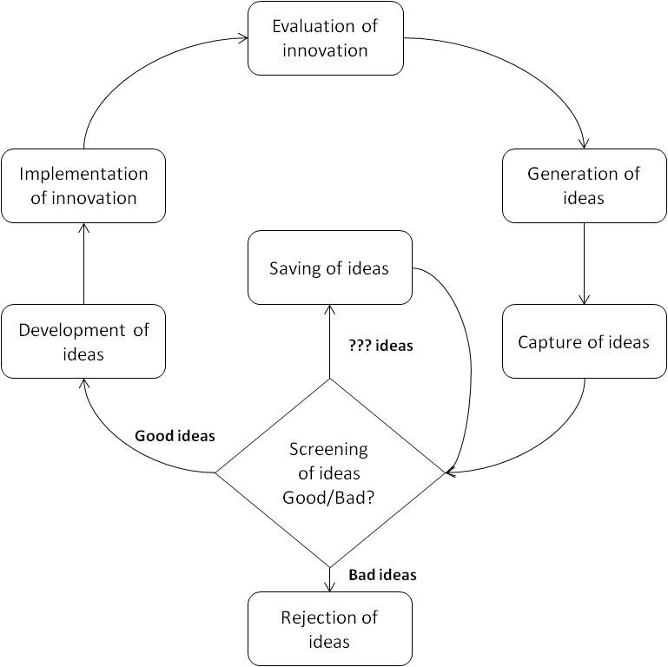
3. Innovation Management
3.2. THE INNOVATION PROCESS

Slide 25
3. Innovation Management
In synthesis, innovation management should include the following elements:
- Promotion and encouragement of the generation of ideas;
- Organization of processes to capture ideas;
- Structure of procedures for analysis and preliminary screening of ideas;

Slide 26
3. Innovation Management
- Organization of processes for the review of the ideas that are not implemented immediately, but should be retained for the future;
- Organization of the innovation process, from the initial design to the launch phase;
- Monitor of the life cycle of the product and assessment of the impact of innovation.

Slide 27
3. Innovation Management
3.3. INNOVATION POLICY
The main pillars on which this should be based are:
A clear strategy;
Planning activities in the short, medium and long term;
A budget for the implementation of planned activities;
A set of indicators for assessing the impact of innovation;

Slide 28
3. Innovation Management
A policy of human resource management, appropriate to the policy innovation management;
A strong knowledge of the markets and their needs (e.g. via suppliers, customers and competitors);
A high technical and technological knowledge.

Slide 29
3. Innovation Management
3.4. EVALUATION OF INNOVATION
The objectives of innovations can vary in nature, which is why its impact is not assessable in a universal way. The company should therefore find appropriate indicators to evaluate the impact.

Slide 30
3. Innovation Management

Slide 31
3. Innovation Management
1.1. XXX
XXX

Slide 32
3. Innovation Management
The evaluation of the impact of innovation should be done in a systematic way.
Depending on the results of the implementation of innovation, the company can evaluate the degree of success of the strategy that has been followed and, if necessary, introduce corrective measures to repositioning, or rethinking the scale of the proposed targets according to the capacity of the company.

Slide 33
3. Innovation Management
In case of failure in innovation, the company should identify their causes.
The company may soon act on the causes and possibly avoid the reoccurrence of the same mistakes in other running innovations or in future processes of innovation.
The failure is natural and the company, as in successful cases, should get the most benefit from it.

Slide 34
4. Innovation Management Systems (ISO)
4.1. INNOVATION MANAGEMENT STANDARDS SERIES
- ISO 50500: Fundamentals and vocabulary
- ISO 50501: Innovation management system
- ISO 50502: Assessment
- ISO 50503: Tools and methods for innovation partnerships
- ISO 50504: Strategic intelligence management
- ISO 50505: Intellectual property management

Slide 35
4. Innovation Management Systems (ISO)
4.2. KEY POINTS IN THE ISO 50501
- Understand the context of the organization and the integration of the global Management System;
- Establish the leadership and commitment of top management;
- Establish the leadership and commitment of top management;

Slide 36
4. Innovation Management Systems (ISO)
- Plan for innovation development;
- Identify and foster innovation enablers/ driving factors;
- Deploy the innovation management process;
- Understand and use innovation management tools and methods;
- Spread innovation culture;
- Assess the performance of the innovation management system and update it if necessary.

Slide 37
4. Innovation Management Systems (ISO)
4.3. ISO 50501 CHAPTERS
0. Introduction
1. Scope
2. Normative references
3. Terms and definitions
4. Contect of the organization
5. Leadership

Slide 38
4. Innovation Management Systems (ISO)
6. Planning
7. Support
8. Operation
9. Performance evaluation
10. Improvement

Slide 39
5. Innovation summary
1.1. XXX
XXX

Slide 40
5. Innovation summary

